Slide 1

Program IDE – C# Program
Supports multiple queries.
Functions similar to a console application.
Ideal for pre-testing components that integrate with backend applications or class libraries.

Slide 2

Writing Queries in the IDE
The program is configured similarly to a C# console application.
Use C# language grammar for statements.
Statements should end with a semi-colon.
Results need a variable to store them.
Display results using the .Dump() method from LINQPad.
Must be wrap in a void main {}
Methods are written below the main method.

Slide 3
Main Method
void Main()
{
// Query Syntax
List<Albums> resultSQ = GetAllAlbumQ(2000);
resultSQ.Dump();
// Method Syntax
List<Albums> resultMQ = GetAllAlbumM(2000);
resultMQ.Dump();
}

Slide 4
Query Method
// image this is a method in your BLL server.
List<Albums> GetAllAlbumQ(int paramYear)
{
var resultQ = from x in Albums
where x.ReleaseYear == paramYear // we need two equals signs for a compare (C# grammar/syntax)
select x;
return resultQ.ToList();
}

Slide 5
Method Syntax
// image this is a method in your BLL server.
List<Albums> GetAllAlbumM(int paramYear)
{
var selectM = Albums
.Where(x => x.ReleaseYear == paramYear)
.Select(x => x);
return selectM.ToList();
}

Slide 6
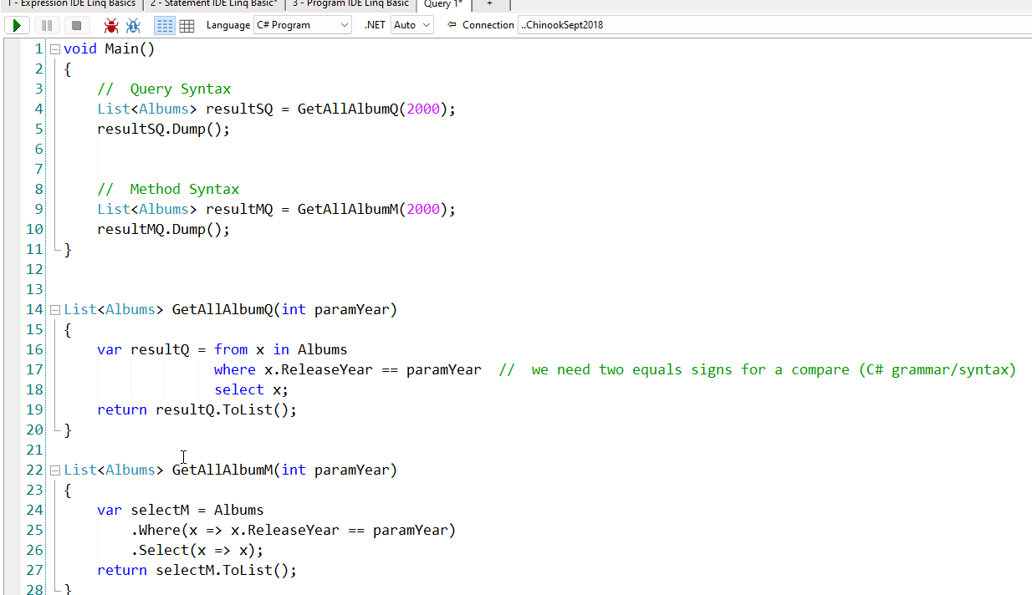
Full Code

Slide 7

Statement Regarding Slide Accuracy and Potential Revisions
Please note that the content of these PowerPoint slides is accurate to the best of my knowledge at the time of presentation. However, as new research and developments emerge, or to enhance the learning experience, these slides may be subject to updates or revisions in the future. I encourage you to stay engaged with the course materials and any announcements for the most current information

